Slide 1
OWW 2011
Living for One World
Valuing and understanding the world and those who live in it
A guide to dissecting this year’s theme
and planning your events

Slide 2

Contents
Introduction
Living for the planet
Living for its people
Living and acting for change
Organising your event

Slide 3

Introduction
This presentation aims to help you:
Explore this year’s theme
Develop a range of ideas for your 2011 event(s)
Think about fun event activities
Notes:
Take time to think about the questions in this presentation. The suggestions made are not designed to be the ‘correct’ answers, nor are they an exhaustive list. They are simply triggers for ways in which you might think about your experiences.

Slide 4

Take a minute to discuss:
What does Living for One World mean to you?
After you’ve discussed, click to reveal some more ideas...
Valuing our planet and all life within it!
Caring for the Earth now - before it is too late.
Learning about the affects of climate change and how to adapt to it.
Understanding that our actions in the UK impact upon the lives of people in some of the poorest parts of the world.
Yes! What we choose to eat, buy and how we travel...this all affects people across the globe.

Slide 5
Living for One World is divided into three sub-topics
Living for the planet
Living for its people
Living and acting for change

Slide 6

Living for the planet

Slide 7
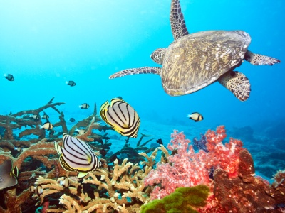

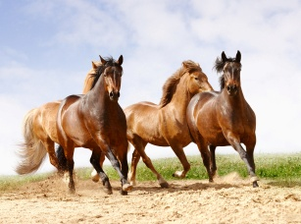
Living for the Planet
Living for the Planet is about changing our lifestyles and attitudes so that we live and work in harmony with nature.

Slide 8

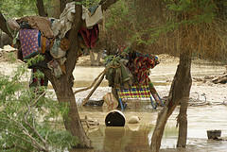
Living for the Planet
How is climate change affecting our planet?
The Earth’s temperatures are rising.
This is causing more frequent extreme weather events, such as floods, droughts and heat waves.
2010 Pakistan floods
Photo: Islamic Relief 2010

Slide 9
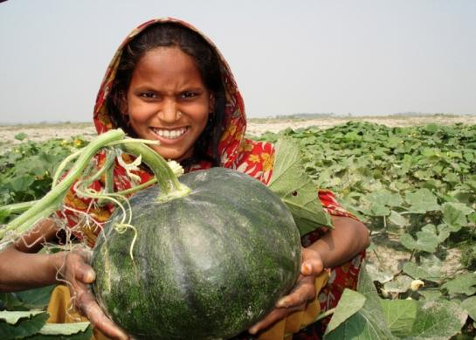
Living for the Planet
How is climate change affecting our planet?
The seasons people rely on to grow crops will become more unpredictable if climate change continues at its current rate.
Some of the world’s poorest people are most severely affected by climate change.
Bangladesh
Photo: Practical Action/Mehrab ul Goni
For a full list of organisations and websites that can tell you more about fighting global injustice, download our free resource: Explore Living for One World
Notes:
Practical Action, Bangladesh, has worked with Shakina and her friends to develop ways of using how to use sand bars temporarily exposed in the dry season to cultivate a crop of watermelons

Slide 10
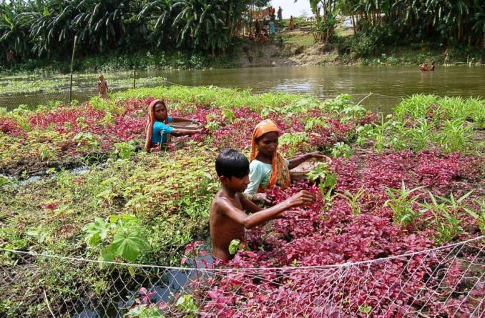
Adapting to a changing climate
Even if we work to reduce climate change, it is highly likely that not all of its effects can be alleviated; we must adapt to our changing climate.
Image here (Sarah, do you have a suitable photo that could be used here? Alternatively, I’ll purchase one from iStockphoto).
The effects of climate change are already apparent, and have a very real impact on the some of the world’s poorest communities.
Floating gardens in Bangladesh
Photo: Practical Action/Mehrab ul Goni

Slide 11
Living for the Planet
How can we adapt to a changing climate?
Through implementing soil and water conservation measures.
Through enhancing the capacity of communities to cope with increasingly unpredictable weather patterns.
Through developing drought-resistant crop varieties.

Slide 12

Living for the Planet
What is biodiversity?
Biodiversity is the diversity of life-forms that inhabit our planet.
Greater biodiversity indicates a healthy planet.
Accelerated environmental change leads to species extinctions.

Slide 13

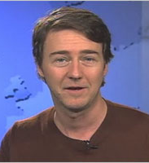
Living for the Planet
2011 is the UN International Year of Forests
Edward Norton, UN Goodwill Ambassador, asks:
  “If you had to choose, would you rather give up one of your lungs and take away all clean water from your kids or pay a little more for a shrimp cocktail and a cheese burger?”
He argues that every year the global community has been making the wrong choices and sacrificing our health, our children’s health and our futures by destroying millions of acres of forests which we depend on for oxygen, clean water and medicines.
For further information, visit: www.un.org/forests
Where you will find excellent short videos

Slide 14


Living for the Planet
How can we care for the planet now, before it’s too late?
This pertinent question is one that you may wish to ask attendees at your event.
See the Living and Acting for Change section of this presentation for ideas on how you can take action!

Slide 15
Living for its People

Slide 16
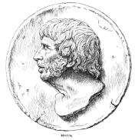
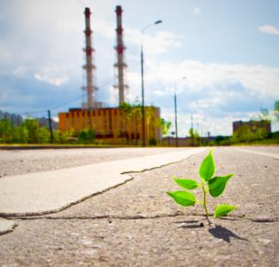
Living for its People
“For greed, all nature is too little”
Lucius Annaeus Seneca
(Roman philosopher, ca. 4 BCE – 65 CE)

Slide 17

Living for its People
Take a minute to discuss:
Do you have family or friends in another country who have suffered from the effects of global injustice?
?

Slide 18

Living for its People
One in seven people in the world go hungry. Why?
Soil depletion?
Rising food prices?
Natural disasters brought about by climate change?
International trading that favours some countries over others?

Slide 19


Living for its People
Oxfam’s GROW campaign is a movement of individuals who care and act. Here are opportunities to help fix the System: actions, resources and information.
This short video offers an example of why the campaign is so important. You could show it at your event or share it with friends – either online or face-to-face.
Whatever you can do you’ll be raising awareness of our broken food system – and what can be done to fix it.
‘...We humans need to grow a great deal in our ability to share what the planet gives us.’
Kate Raworth
Senior Researcher
Oxfam GB
http://www.oxfam.org.uk/get_involved/campaign/food/

Slide 20
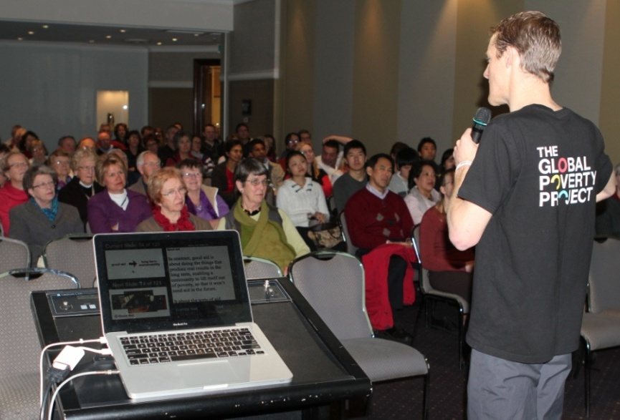
Living for its People
The Global Poverty Project presents
1.4 Billion Reasons
a multi-media presentation that is travelling the globe engaging and inspiring audiences to understand and get involved in the movement to end the extreme poverty of 1.4 billion people.
1.4 Billion Reasons has been tailored to specific audience groups and delivered by expert presenters for between 45 and 90 minutes in:Workplaces, schools, universities, faith groups, community groups and at conferences
How about having a presentation at your
OWW event ?
To find out more and to book a speaker, visit:
http://www.globalpovertyproject.com/pages/presentation

Slide 21

Faith and the environment
The world’s religions were the first environmental campaigners.
By understanding the role that faith can play in protecting the environment, we can begin to work together towards a better, more sustainable future.
Visit www.oneworldweek.org to download our free multi-faith resource: Environment Across Faiths

Slide 22
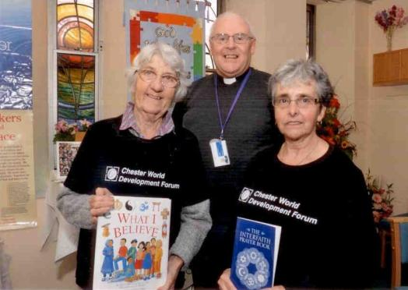
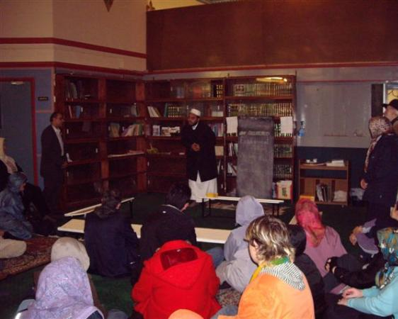
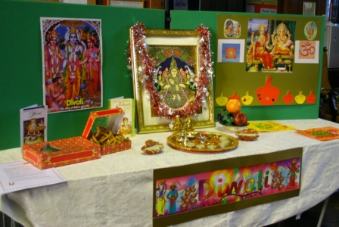
Some of your previous OWW multi faith events
Chester World Development Forum
Chester, 2010
One World Walking Together event
Jami Mosque, Portsmouth 2007
Diwali stall
Southampton, 2009

Slide 23
Living and acting for change

Slide 24
Take a minute to discuss:
What do you think stands in the way of creating a more sustainable world ?
After you’ve discussed, click to reveal some more ideas...
Poverty
Greed
Corrupt Governments
Wastefulness
Disease
Prejudices
Exploitation
Fear

Slide 25
What can I do?
How can I encourage myself and those around me to help bring about positive change in our world?

Slide 26
Stop climate change getting worse: adjust your lifestyle to reduce your carbon footprint.
Turn off your electrical items when not in use.
Turn down the central heating thermostat by one degree.
Compost your food waste.
Switch off your lights when you leave the room.
Replace your light bulbs with energy saving ones.
Don’t tumble dry your washing – hang it out instead.
Choose electronic bills and statements.
Ride a bike instead of taking the car when making short trips.

Slide 27

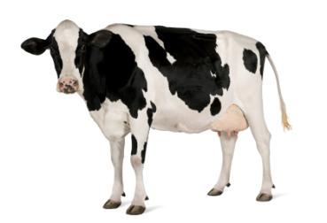
Eat fewer meat and dairy products
Farming livestock, especially cows, releases significant levels of carbon dioxide, methane and nitrous oxide: gases that cause much of our global warming.
Free-range grass-fed animals are happier and healthier producing meat more efficiently than livestock reared indoors on vast factory farms which require massive inputs of fossil fuels and feed grains, grown at the expense of grains for human food.
If we ate less meat we could afford
free-range meat and reduce harmful gas emissions.

Slide 28

Save water
Water is a very precious resource; take only what you need as it is not as plentiful as you may assume.
According to the UN Millennium Goals Report 2010, ‘safe water supply remains a challenge in many parts of the world’.
During the last decade, global demand for water has increased due to expanded activity in agriculture and manufacturing.
These activities have also contributed to water pollution.

Slide 29
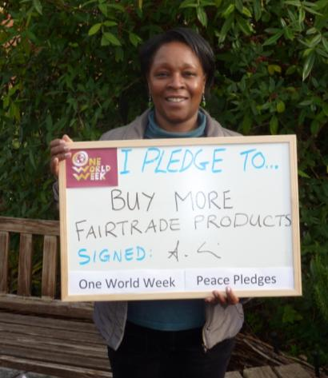
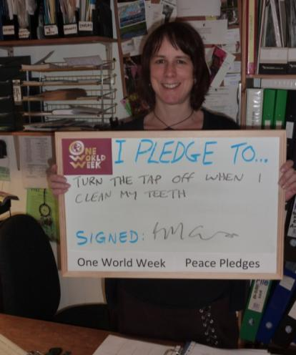
Make an environmental pledge
Visit www.oneworldweek.org and commit yourself to one of our environmental pledges.
This is a great activity do at your OWW event.
Images above and left: 2010 Peace Pledges

Slide 30




Support a charity
You could choose a charity and support one of their programmes. Below are some charities you may wish to support.
www.christianaid.org.uk/
www.practicalaction.org/
www.actionaid.org.uk/
www.islamic-relief.org.uk
www.cafod.org.uk/
For a full list of organisations and websites that can tell you more about fighting global injustice, download our free resource: Explore Living for One World

Slide 31
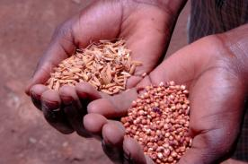
Support overseas adaptation programmes
You could support overseas adaptation to climate change through donating to aid agencies’ projects and programmes.
The Cafédirect Producers Foundation (CPF) is working on a project with smallholder tea partners in Kenya and Uganda to develop and implement strategies to help farmers address and adapt to changing climatic conditions.
For more information, visit: http://www.adapcc.org/download/Adap-CC_Update-from-pilot-groups_201009_en.pdf
For further useful information on adaptation to climate change, read Tearfund’s report: Adaptation United.
To download, visit:
http://tilz.tearfund.org/Research/Climate+change+reports

Slide 32

Campaign against climate debt
The UK helps developing countries adapt to the effects of climate change through loans lent through the World Bank.
This is unjust, as much of the responsibility for climate change rests with the actions of richer countries.
Delivering assistance through grants, not loans, would be more ethical.
Jubilee Debt Campaign and the World Development Movement have launched a campaign to prevent loans creating further poverty.
Visit: http://www.jubileedebtcampaign.org.uk/

Slide 33
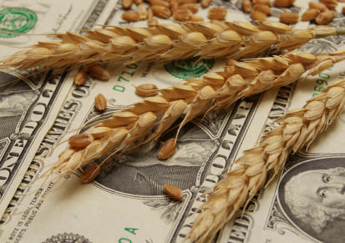
Campaign for fairer trade:
E.g. WDM’s campaign for food speculation
This leads to food becoming unaffordable; families already living in poverty suffer from increased hunger and malnutrition.
Banks, hedge funds and pension funds bet on food prices in the financial markets.
This contributes to severe swings in the price of everyday foods such as wheat, maize and soy.
Our world needs national and international policies which put the needs of the planet and its people first.
To take action, visit the World Development Movement’s campaign:
http://www.wdm.org.uk/food-speculation

Slide 34

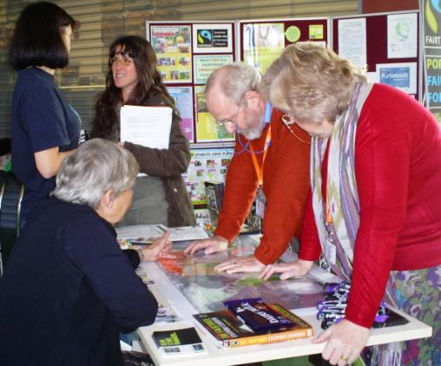
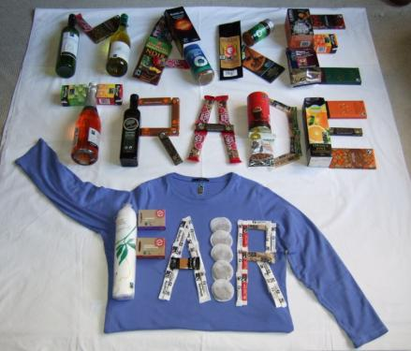
Campaign for fairer trade:
raise awareness
You could promote Fairtrade at your OWW event.
People playing a Fairtrade game about where products come from.
OWW Portsmouth, 2009
Visit http://www.fairtrade.org.uk/ for information and resources to get you started!

Slide 35
Support an environmental campaign
Below are some current campaigns you may choose to support at your event:
World Development Movement
Stop bankers betting on food: campaign to limit commodity speculation.
www.wdm.org.uk/food-speculation
Oxfam
GROW Campaign: raising awareness of our broken food system – and what can be done to fix it.
www.oxfam.org.uk/get_involved/campaign/food
Stop Climate Chaos Coalition
Stop Climate Chaos is a coalition of organisations working towards the reduction of climatic change.
http://www.stopclimatechaos.org/
For a full list of organisations and websites that can tell you more about fighting global injustice, download our free resource: Explore Living for One World

Slide 36
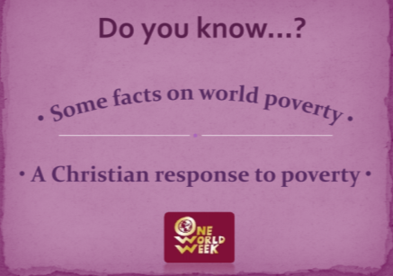

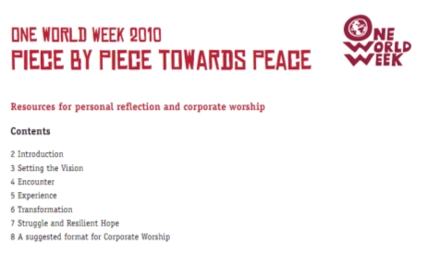
Learn about different faith perspectives
You could learn about different faith perspectives on what it means to Live for One World, at your OWW event.
Visit www.oneworldweek.org to download our free multi-faith resource: Environment Across Faiths

Slide 37
Organising your event

Slide 38
Which aspects of Living for One World would you like to promote at your event?
Here are some suggestions...
Living for the Planet
Living for its People
Living and Acting for Change
The affects of global warming
Adapting to a changing climate
Food production
Biodiversity
Hunger and food distribution
Global inequalities of wealth
and consumption
Faith/ multi-faith perspectives
Supporting the work of charities
Supporting campaigns
Buying and promoting Fairtrade
Learning about another religion
Cutting your carbon footprint

Slide 39
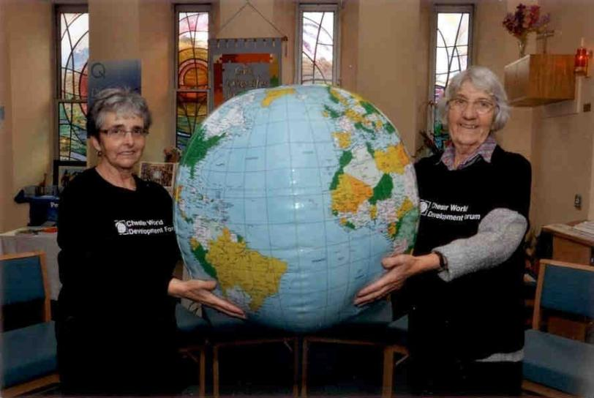
A typical OWW event?
There is no such thing as a typical OWW event!
However, there are some common features...
All OWW events should raise awareness of global justice issues.
OWW events can be multi-faith and multi-cultural.
OWW events should provide new information, ideas and perspectives.
OWW events should encourage attendees to take further action.

Slide 40


Organising your event
Gather together everyone’s thoughts and ideas on which aspects of the theme to focus on.
Are there any common viewpoints?

Slide 41
OWW resources and activities
Check out our OWW resources: www.oneworldweek.org
Real life
Stories to Inspire
Environmental Pledges
Living for One World Quiz
Living for One World Word search
Living for One World Poster and Leaflet
Environment Drama script
Website Links for further information
Christian Worship Anthology
Multi faith Perspectives resource
Film guide
Slideshow presentation on the theme

Slide 42
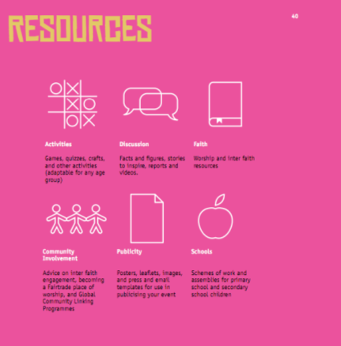
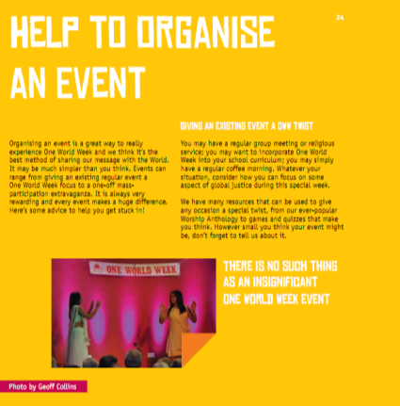

Download the OWW Handbook for further advice
The OWW Handbook is our comprehensive guide to organising your OWW events.
To download your free copy, visit:
www.oneworldweek.org
Or contact the OWW office to order a card copy.

Slide 43
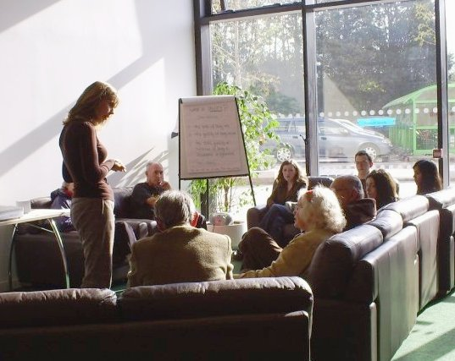
Start planning!
Once you have decided on the theme of your event and what you want to achieve, it’s time to start planning!
Good luck, and remember to have fun!
OWW Workshop, Portsmouth 2009

Slide 44
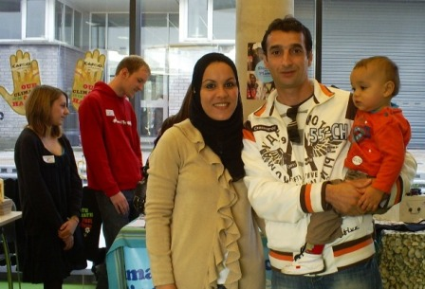
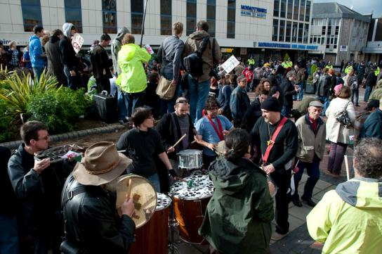
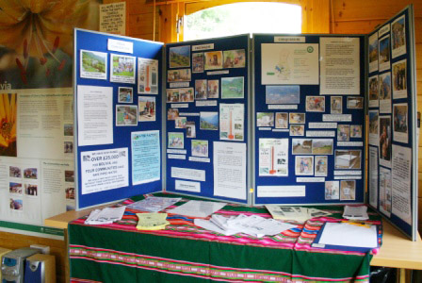
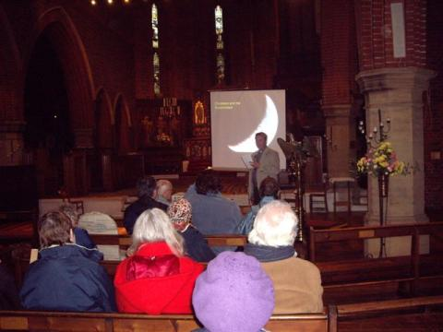
Photos from your past events
Portsmouth, 2009
Newport, 2009
Bournemouth, 2009
Portsmouth, 2007

Slide 45
Living for One World
A guide to dissecting this year’s theme and planning your events
Written and compiled
for One World Week 2011
by
Sarah Kilou
Developed from an idea initiated by Sam Kennedy,
OWW researcher and writer from October 2010 to March 2011

